Slide 1
Welcome! ¡Bienvenidos!
Duke Talent Identification Program
7th Grade Talent Search
Notes:
Welcome to Duke TIP. We are glad you have joined us and hope this session provides you with new and helpful information.

Slide 2
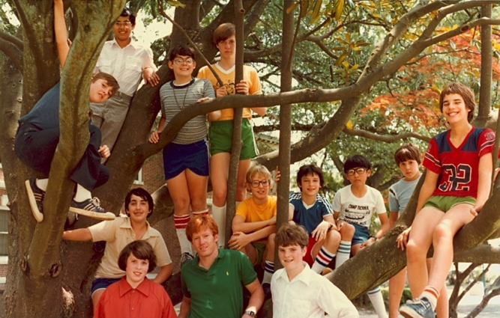
What is Duke TIP?
Non-profit identification and support services for the academically gifted
Founded in 1980, more than 2.5 million participants
Educational opportunities and resources
Notes:
Duke TIP is non-profit and operates under the direction of Duke University. TIP stands for Talent Identification Program and is dedicated to the identification and support of academically gifted students.
Was founded in 1980, and more than 2.5 million students have participated. The structure of the program is to reach out and support gifted programs in schools, as well as, assist families in guiding their talented children.
Duke TIP offers a wide array of fulfilling educational opportunities and resources
Provides fulfilling and advanced learning opportunities
Offers learning tools, information, and resources to enhance the academic experience

Slide 3
"Everybody around me was somehow able to take nerd camp and turn it into the best three weeks of our lives."
Notes:
Here is a photo from one of the TIP summer camps to give you a visual picture of one of the programs.

Slide 4
Together we serve.
What is Duke TIP?
Duke TIP
Working with students, educators, and their families
Academically Talented Students
Parents & Families
Educators
Notes:
The student is the center of what we do. It takes all of us invested and working together to increase the chances for greater success. TIP continuously works and collaborates with GT Coordinators and teachers in the schools to find the gifted youth. Educators help to identify those who qualify and then informs the students of the opportunities TIP offers. However, the parents and family members are very important to the process. They understand their child and often seek more for their child’s advancement. It takes all of us working together to encourage gifted students to reach their maximum talent and increase the chances for greater success.

Slide 5
Talent Search Model
Network of Programs & Resources
Talent Search
Motivation and Encouragement
4th–6th Grade
7th Grade
Above-level Assessment
Special Support
Notes:
At Duke TIP, Talent Search is only one department but is the entry point for students to participate. There are two talent searches. Students may join the younger talent search as early as the 4th grade and may continue with TIP, by applying for the 7th Grade Talent Search, which offers programs through high school. This model shows that both of our talent searches support the needs of gifted students. Both searches provide: above-level testing and appropriate assessment measures, access to Duke TIP’s network of educational programs and resources, and most importantly motivation and encouragement for students focused on academic achievement. We are here today to focus primarily on the 7th Grade Talent Search.

Slide 6
Talent Search
Where the TIP experience begins.
Identification, academic challenge,
and peer interaction through resources and programming
Participation
Enrollment
Identification
Notes:
As stated, Talent Search is where the TIP experience begins. The process starts with identifying the student’s giftedness & qualifying for the program, then enrolling which opens the opportunities for participation.

Slide 7
Eligibility
Current 7th graders (or a current 8th grader who skipped 7th grade)
At or above the 95th percentile in at least one qualifying subtest area
Check TIP’s website for acceptable tests and scores
www.tip.duke.edu/7enroll
Notes:
Eligibility is an Honor!
This talent search is for current 7th graders (or 8th graders who skipped 7th grade during the current year).
To qualify, they must have scored at or above the 95th percentile on an acceptable achievement subtest area or IQ test. We have provided an extensive list of these tests on our website. If there are complications regarding the availability of a student’s scores, a coordinator or teacher may recommend the student, who they feel is qualified to participate. Parents and teachers know the students best! As stated in the 7th Grade Coordinator’s Guide, you may indicate this recommendation on the notification letter by writing in “coordinator recommendation” in the test name in the Qualifying Test Score section.
On the paper application, the student will select “other” as the test name and then write in “coordinator recommendation”
Or, online, student will select “coordinator recommendation” from the drop down list of qualifying test names.

Slide 8
Participation is Rewarding!
Special motivation to focus on academic achievement and self-challenge
Interact with academic peers
Access an array of opportunities and resources
Assess intellectual abilities through above-level testing and assessment
Notes:
For the student who needs more of a learning challenge than what they receive in the regular classroom, Duke TIP resources and programs will add value to the learning experience. Through engagement, a student will gain more self-confidence, feel more connected and meet other students who are smart like themselves.

Slide 9
Above-Level Testing
Taking the ACT or SAT as a 7th grader
Invaluable knowledge and experience
Gain insight into academic abilities
Preview the same test taken during the college admissions process
Notes:
Testing is required for students who enroll in this program. As part of their talent search enrollment, Duke TIP will register the student for either the ACT or the SAT. As well, after receiving their test scores, we provide helpful insights about their abilities and aptitudes. Most parents and students place strong value on this benefit. Also, taking the test gives them the opportunity to preview the same test they will face during the college admissions process.

Slide 10
Above-Level Testing: ACT vs. SAT
We do not recommend one test over another. Here are some standard facts…
ACT
Measures academic achievement
Four sections: Math, English, Reading, Science (Writing optional)
36 possible points on each section
SAT
Measures critical thinking, analysis, problem-solving
Three sections: Math, Critical Reading, Writing
800 possible points on each section
www.tip.duke.edu/7tests
Notes:
Yes, this is a challenging test but these students have excellent academic abilities. The tests are approximately 4 hours long and they will likely be taking the test alongside high-school juniors or seniors. We don’t recommend one test over another, both are great tests. We recommend choosing the test with the best date/time and location that works for you. This slide shows some of the facts about each tests.

Slide 11
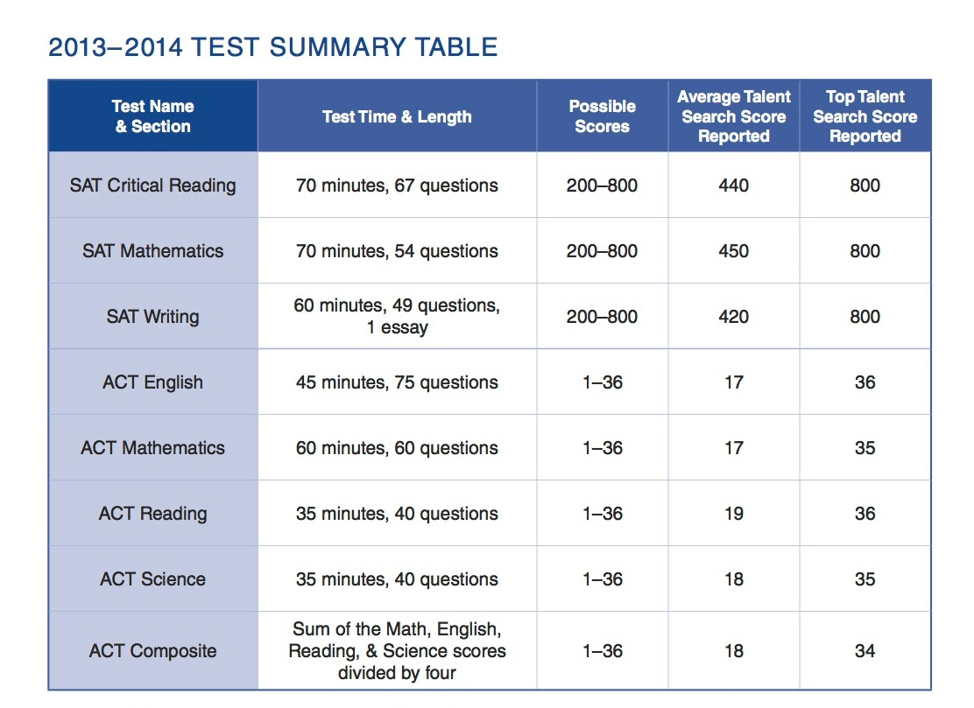
Score Results Summary
Notes:
Students receive two reports to interpret their scores: one from the testing agency that compares seventh grade cores to recent U.S. high school graduates; and a more detailed results summary, mailed in May, which allows families to understand how students performed relative to other 7th graders in the talent search. The TIP results summary, exclusive to TIP participants, also provides suggestions for further educational development based on their performance.

Slide 12
Recognition
In addition to receiving a certificate of merit, students who receive outstanding scores are honored at award ceremonies
www.tip.duke.edu/ceremonies
Notes:
All students who test will receive a participation certificate of merit. Those who test by March and receive outstanding scores on the ACT or SAT will be honored at special recognition ceremonies held in states with the largest enrollment. Students who qualify will receive a letter of invitation from Duke TIP and may RSVP online, if they plan to attend the ceremony. Ceremonies are held the last three weeks in May and first week in June.

Slide 13
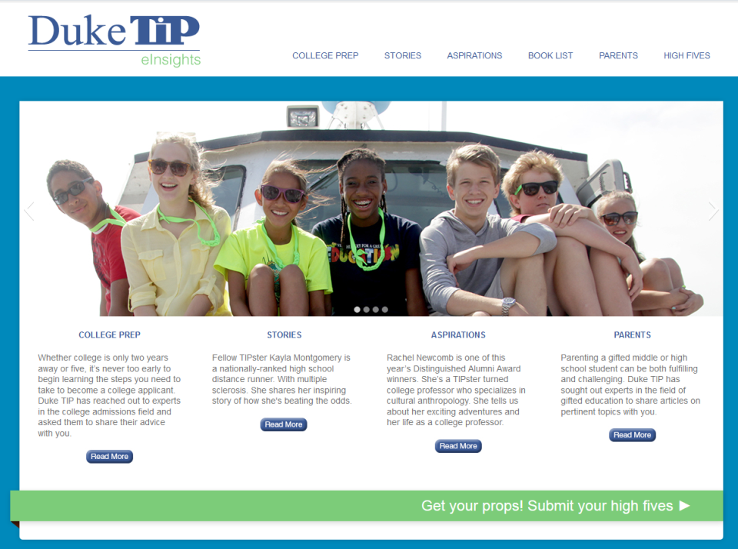
Helpful Resources
The Talent Search Experience and eInsights
Academic development and college planning through eleventh grade
Educational guidance for families at any time
Notes:
As part of Duke TIP, students will receive special publications designed to help them learn about their potential, what other students are doing with their academic talent, plan for high school and college, and access resources to assist them in achieving their educational goals. Students receive The Talent Search Experience in the 7th grade and the online eInsights newsletters twice a year through their 10th grade year.

Slide 14
Helpful Resources
My College Guide
Features select U.S. colleges and universities
Information about applying and getting in to college
Highlights different majors and careers to consider
Accessible to students in tenth and eleventh grades
Notes:
Students will receive either a hard copy or an online version when in the 10th and 11th grades. This helpful guide provides current and appealing information about US colleges and universities, which will guide them in making informed choices for their career and college experience.

Slide 15
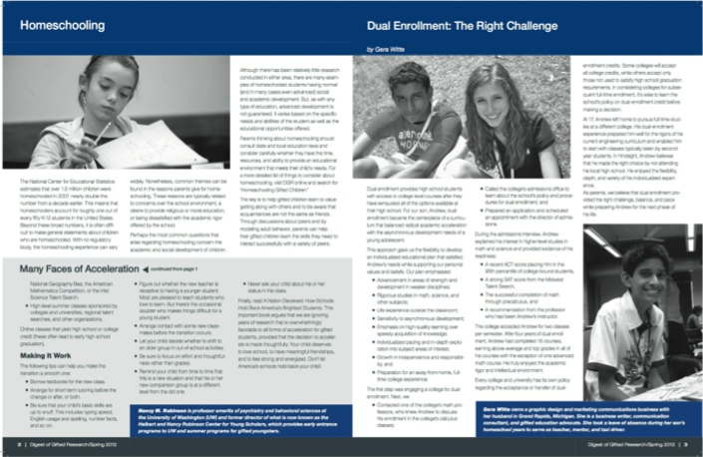
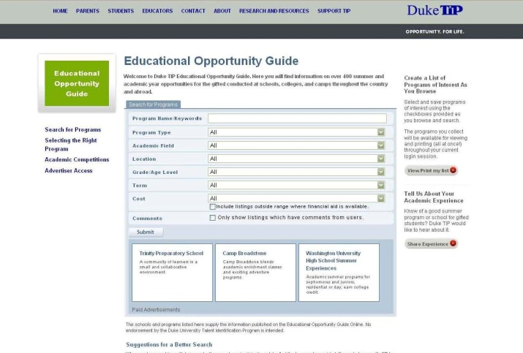
Helpful Resources
Digest of Gifted Research Online newsletter providing research-based information on rearing and educating academically talented children.
Educational Opportunity Guide
A searchable, online directory containing listings for schools, summer programs, and academic competitions across the United States and abroad.
Notes:
The Digest of Gifted Research (DGR) is an online resource that provides parents of academically talented youth with conceptual, theoretical, and practical information about their children. These articles are carefully written to be both understandable and useful to families seeking advice on how best to educate gifted children.
The Educational Opportunity Guide is an exclusive searchable online directory maintained by TIP that contains hundreds of listings for schools, summer programs, and academic competitions across the United States and abroad.

Slide 16
The Princeton Review through Duke TIP
LiveOnline ACT or SAT test prep courses
Prepare for the test with other TIPsters
Discounted price available exclusively to talent search participants
Accessible in grades ten through twelve
Notes:
Talent Search participants can take advantage of discounts on our rigorous and engaging ACT and SAT prep courses through Princeton Review (available in 10-12 grades).

Slide 17
Enrollment is Easy
Enrollment Deadline
Test | Test Dates | Paper Application Postmark Deadlines | Online Enrollment Deadlines
SAT | 12/6/14 | 10/1/14 | 10/21/14
ACT | 12/13/14 | 10/1/14 | 10/21/14
SAT | 1/24/15 | 11/4/14 | 12/9/14
ACT | 2/7/15 | 11/4/14 | 12/9/14
For expedited processing, enroll online at www.tip.duke.edu/enroll
Or, mail paper applications to Duke TIP
Talent search fee: $75
Notes:
Enrolling online is easy and you will need a MasterCard or Visa credit card. Students enrolling online will immediately receive access to The Talent Search Experience, a practice test, and information about an acceptable form of ID to bring on the day of the test. The enrollment fee is $75 and covers the registration fee and the cost of the test. It is a one time fee to participate in the 7th Grade Talent Search program. (Online enrollment is not an option for students requesting a non-Saturday test date or for students who have a physical or learning disability that requires a testing accommodation.)
To enroll by mail, a student must complete a paper application (usually available through school GT coordinator), enclose a check or money order and mail to Duke TIP. Within 5 weeks, students will receive a follow-up packet that includes: The Talent Search Experience, a practice test, and information about an acceptable ID to bring on the day of the test.
Visit our website and plan to join us this year for a webinar to learn more about TIP and the enrollment process. www.tip.duke.edu/webinars

Slide 18
Financial Aid
Qualify for free or reduced lunch and fee is only $30
More than $3 million awarded across all programs in 2014
www.tip.duke.edu/7fees
Notes:
Yes. We do have financial aid and it is available for students who can validate that they qualify for free or reduced lunch. Duke TIP is very generous and supports many participants through our Fee Grant process. The Coordinator’s Guide provides details about how to present this information when you complete your application. The reduced fee is $30 and required for enrollment.

Slide 19
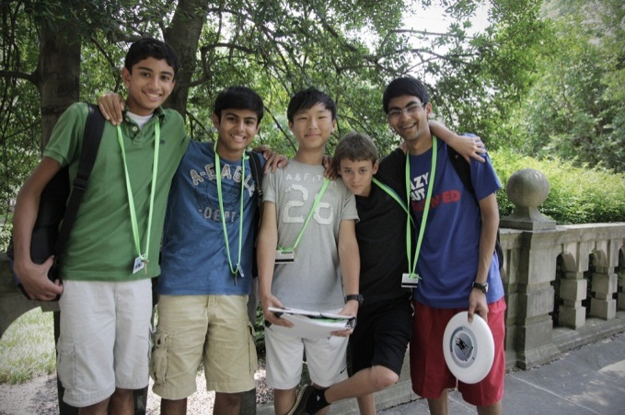
Educational Programs
Outstanding learning opportunities for grades 7 and up
Notes:
Another department within Duke TIP is Educational Programs. The EP staff develop curriculum/materials and facilitate learning for many specialized and unique programs for talented youth. Scholarships are available for those who meet the criteria and detailed information is available at the website. Some programs require special qualifications as we will show you in the slides to follow. Duke TIP Educational Programs seek to engage students beyond the regular classroom with new academic challenges and guide them in utilizing their aptitudes at higher levels of learning.

Slide 20
Scholar Weekends
Grades eight through eleven
Weekend-long enrichment courses during the academic year
Courses may include marine biology, astronomy, creative writing, politics and the media, video production, and poetry
Multiple sites across the country
www.tip.duke.edu/scholar
Notes:
Scholar Weekends are held on the following campuses:
Duke University – Durham, NC
New College of Florida – Sarasota, FL
University of Kansas – Lawrence, KS
University of Houston – Houston, TX
University of South Carolina – Columbia, SC
University of Georgia – Atlanta, GA
Need based scholarships are available for those who qualify.

Slide 21
Distance Learning: eStudies
Grades seven through eleven
Seven-week summer program
Challenging academic coursework
Teacher-moderated, internet-based classroom
Highly interactive: students connect with other gifted students and with their Duke TIP instructor through live chats, discussion boards, blogs, and email
Class examples include Academic Writing, Anatomy and Physiology, Neuroscience, and Psychology
www.tip.duke.edu/distance
Notes:
These courses are popular among our participants and virtually engage the students both academically and socially.

Slide 22
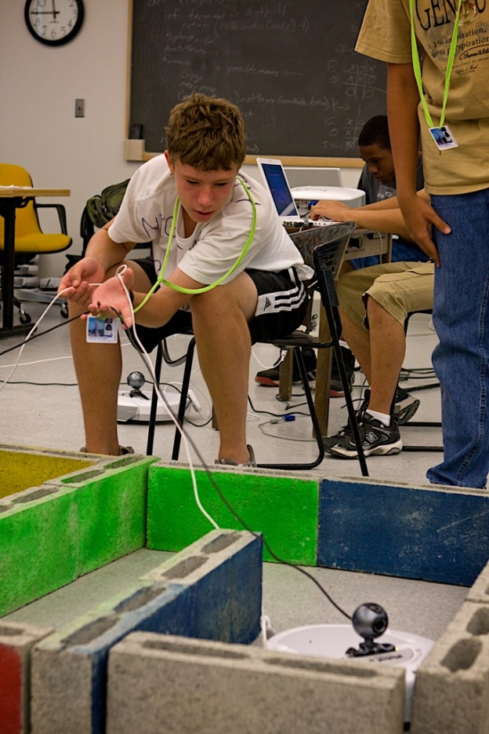
Summer Studies
Grades seven through ten
Three-week summer residential programs
Appalachian State University
Austin College
Davidson College
Duke University
Duke University Marine Lab
Georgia Tech
University of Georgia
University of Kansas
Rice University
Trinity University
Wake Forest University
www.tip.duke.edu/summer78
Notes:
Exceptional performance on the ACT and SAT will qualify some students to participate in Duke TIP’s renowned Summer Studies Programs. These are 3-weeks, residential programs with intensive academic sessions on college campuses. Here we have listed the campuses where these program are held.

Slide 23
Summer Studies: Experience
Fast-paced, rigorous, and above-grade-level curricula
Expert instructors with zeal for their subject area
Experiential learning methodology
Environment promotes academic and social growth
Notes:
While the students are learning academically, they are building peer relationships with other gifted/talented youth.

Slide 24
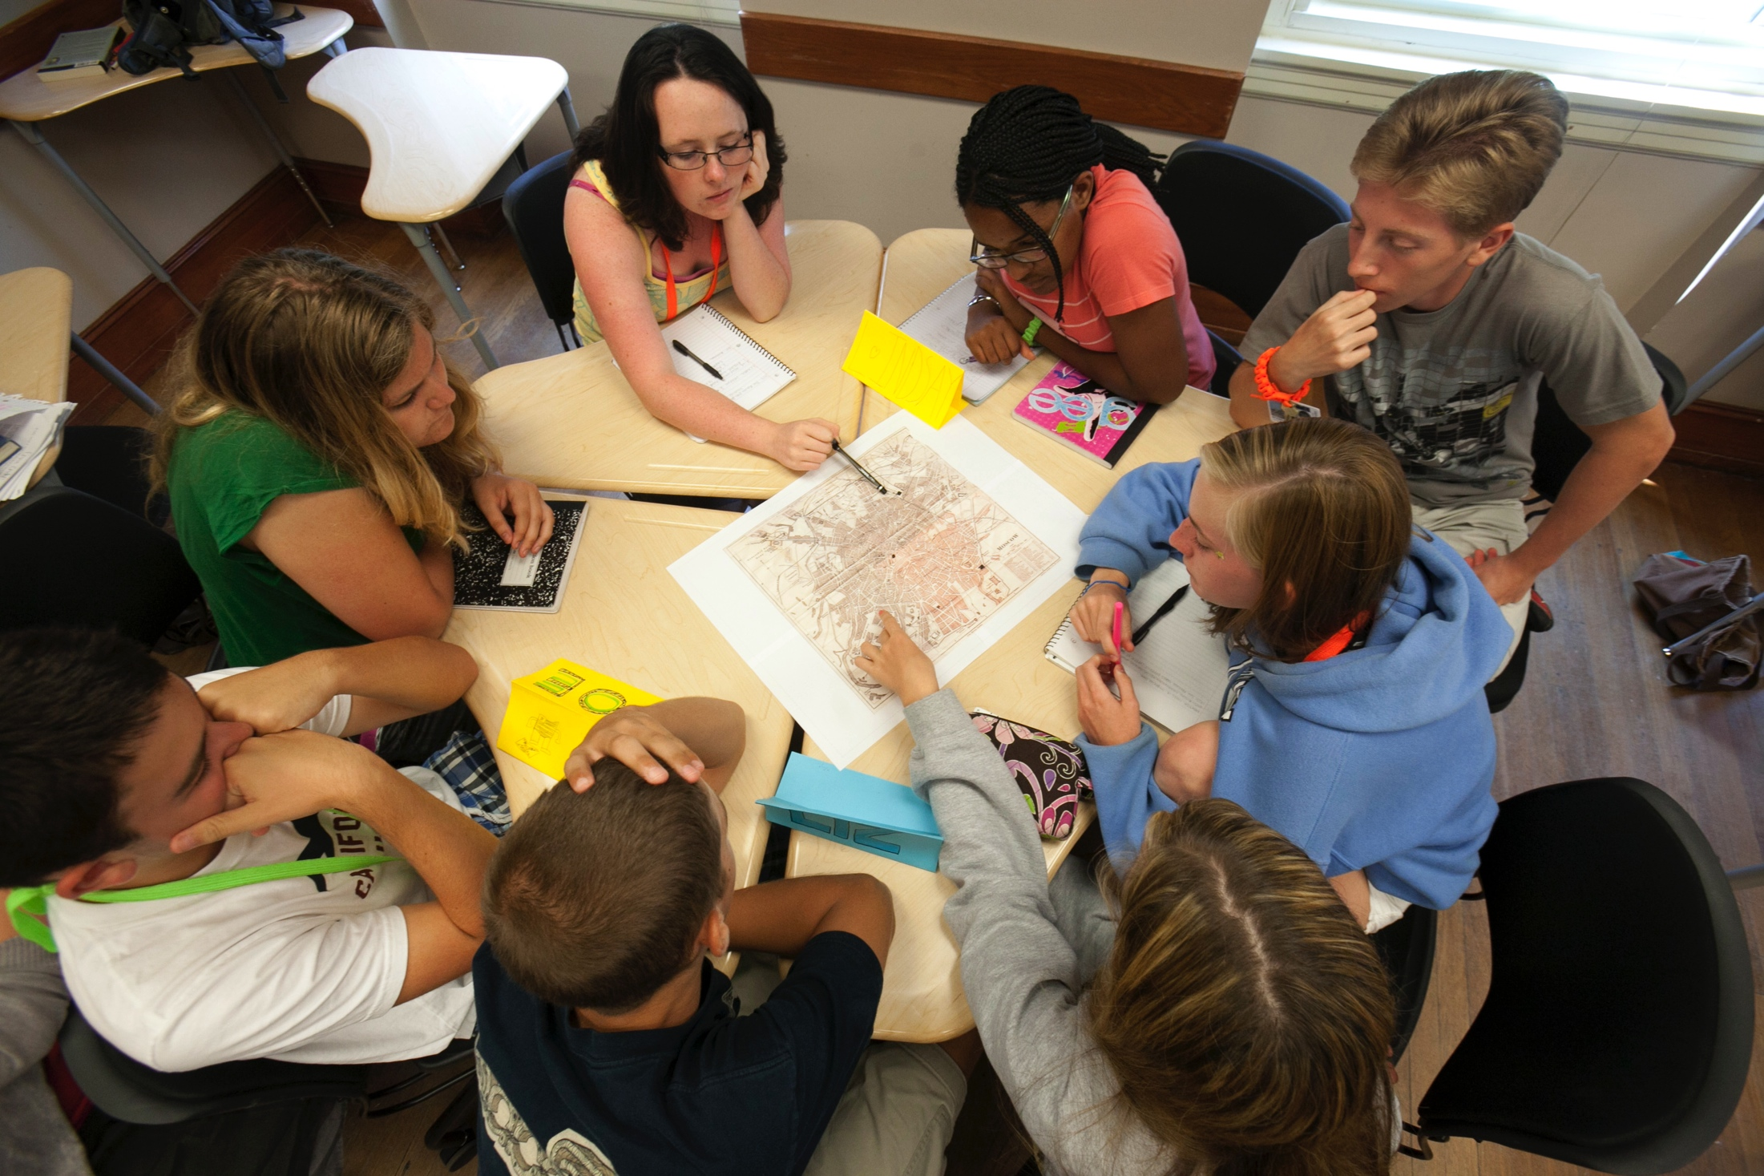
Notes:
Another photo from summer programs that shows team engagement with these pre-high school students.

Slide 25
Field Studies
Grades nine through twelve
Two-week programs
Domestic and international offerings, such as:
Creative Writing – Ghost Ranch, NM
International Justice – Netherlands
Tropical Medicine – Costa Rica
www.tip.duke.edu/FS
Notes:
Field Studies gives the students an academic experience in a unique setting. They gain new understanding of the world around them.

Slide 26
Rosetta Stone®
Discounted, one-year subscription
Uses speech recognition technology and real-life simulated conversations
25 available languages including Spanish, Chinese (Mandarin), Hindi, German, and more!
www.tip.duke.edu/Rosetta
Notes:
Rosetta Stone. A great perk! Reduced prices on one-year subscriptions to this renowned online language-learning program.
Uses speech recognition technology and real-life simulated conversations.
25 available languages including Spanish, Chinese (Mandarin), Hindi, German, and more!

Slide 27
Independent Learning
Grades four through twelve
No qualifying criteria
Self-paced, various formats: CD-ROM, workbook, or online
Students work with a local mentor
Participants and schools receive a discount!
www.tip.duke.edu/learn
Notes:
Yes. We have many courses that give students the opportunity to learn on their own, independent of their regular classroom and there is no qualifying criteria. Lots of topic choices and learning can happen anywhere.

Slide 28
Partnerships: Young Scholars Program
Scholarship opportunity for high achieving 7th graders with financial need
Provides educational opportunities through high school, such as:
Attending academic enrichment programs
SAT/ACT preparation
Internship opportunities
Career exploration, college admissions prep, and more!
Apply in spring of 7th grade year
For more information, visit www.jkcf.org
Notes:
This is a great scholarship program for 7th graders with financial need. This amazing program supports qualified students through high school with unique opportunities. We appreciate your help in identifying qualified students.

Slide 29
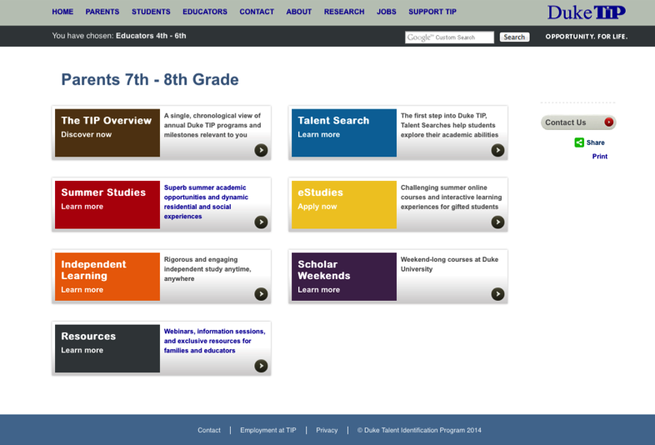
www.tip.duke.edu
Notes:
We have provided you with general information in this presentation but our website provides more details about the 7th Grade Talent Search. Visit our website to learn even more.

Slide 30
“TIPsters are a special, unique brand of student and give me renewed hope for the future. I cannot say enough about how much the program has meant to both of my children.” TIP Parent
"TIP was the best experience of my life.
It's like coming home." TIP Participant
Notes:
Here are a few testimonials – a parent and a student.

Slide 31
Contact Information
Allene Byroad
Staley Middle School
byroada@friscoisd.org
(469) 633-4513
Duke TIP Contact Information
7talent search@tip.duke.edu
(919) 668-9100
Notes:
We hope this information and session has been helpful. If you have any questions, you may call or email us using this contact information. We wish you and your students much success as they progress through years of learning and development in achieving their educational goals. Thank you.

